Slide 1
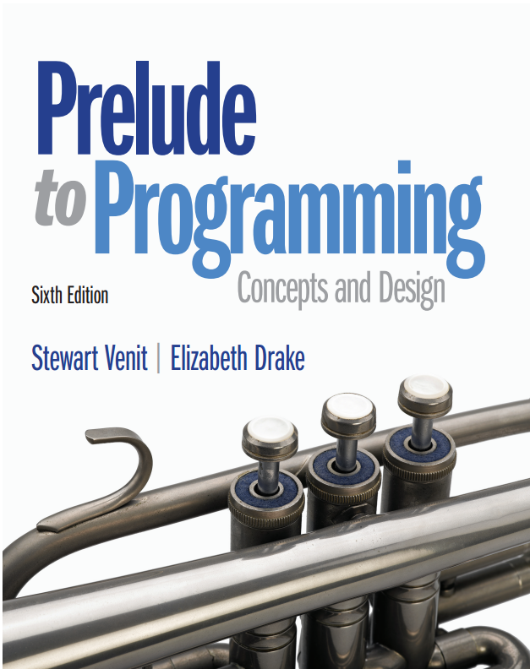
Prelude to Programming
Sixth Edition
Chapter 5
Repetition Structures: Looping
Copyright © 2015, 2011, 2009 Pearson Education, Inc. All Rights Reserved
Notes:
If this PowerPoint presentation contains mathematical equations, you may need to check that your computer has the following installed:
1) MathType Plugin
2) Math Player (free versions available)
3) NVDA Reader (free versions available)

Slide 2
5.1 An Introduction to Repetition Structures: Computers Never Get Bored!

Slide 3
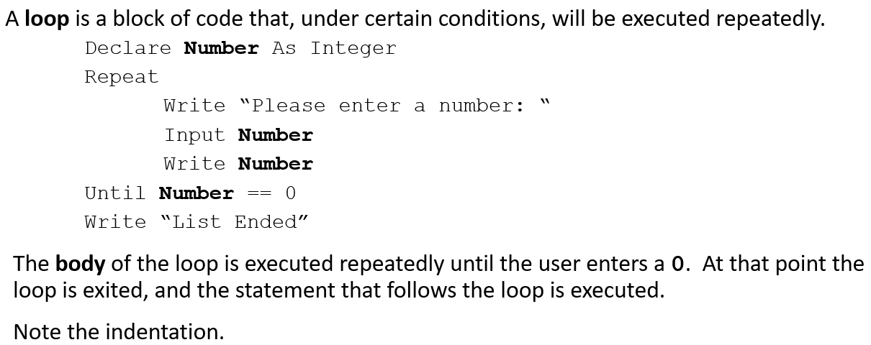
5.1 An Introduction to Repetition Structures: Computers Never Get Bored!

Slide 4
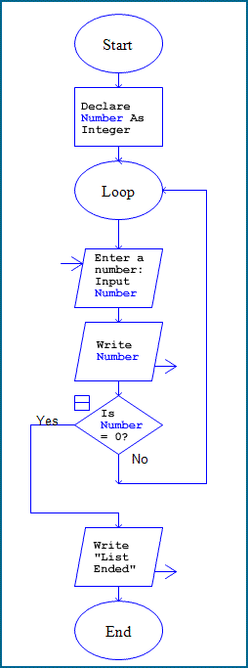
Flowchart:

Slide 5
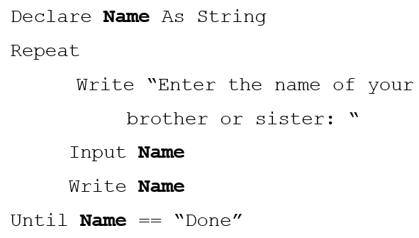
Iterations
How many times will the loop run? Each time the loop runs it is called an iteration.
Jim has 2 brothers & 1 sister: 4 iterations
Marie has 1 sister: 2 iterations
Can we create a loop that doesn’t use the test condition as one of the iterations? Yes … we’ll see how later.

Slide 6
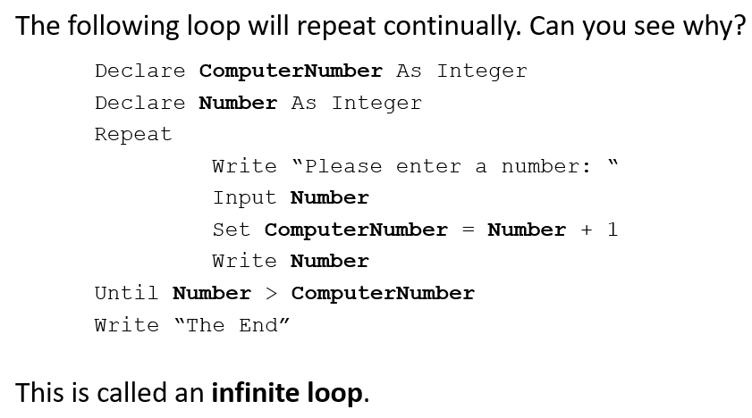
Beware the Infinite Loop

Slide 7
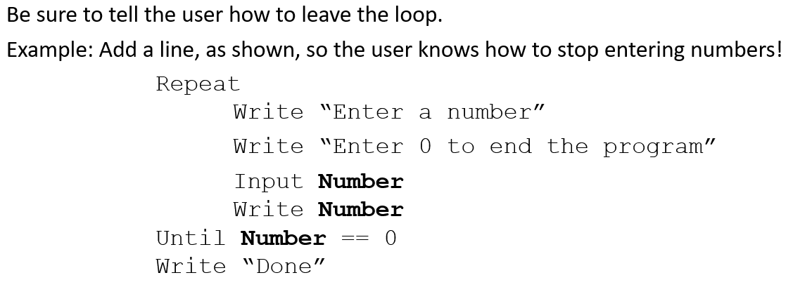
Don’t Let the User Get Trapped in the Loop

Slide 8
Review: Comparison and Assignment Operators
As an assignment operator, the equals sign sets the value of an expression on the right side to the variable on the left side.
As a comparison operator, the double equals sign asks the question, “Is the value of the variable on the left side the same as the value of the expression, number, or variable on the right side?”
a single equals sign (=) signifies the assignment operator
a double equals sign (==) signifies the comparison operator

Slide 9
Review: Relational and Logical Operators and Compound Conditions
Relational operators are the symbols used in the condition to be evaluated:
== is the same as (the comparison operator)
!= is not the same as (not equal to)
< less than
> greater than
<= less than or equal to
>= greater than or equal to
Logical operators are used to connect simple conditions into a more complex condition called a compound condition.
The simple conditions each contain one relational operator.

Slide 10
Review: AND, OR, and NOT Logical Operators
A compound condition joined by AND is true only if both simple conditions are true. It is false otherwise.
If (X > 5) AND (X < 10) Then...
is true if X is 6, 7, 8, or 9, both greater than 5 and less than 10.
A compound condition joined by an OR is true if one of the simple conditions is true. It is false only if both are false.
If (Response =“Y”) OR (Response =“y”) Then...
is true if Response is uppercase (“Y”) or lower case (“y”).
NOT affects only one condition. A condition with the NOT operator is true only if the condition is false.
(X > 100) AND NOT(X == Y)
is true only if X is greater than 100 but not equal to the value of Y.

Slide 11
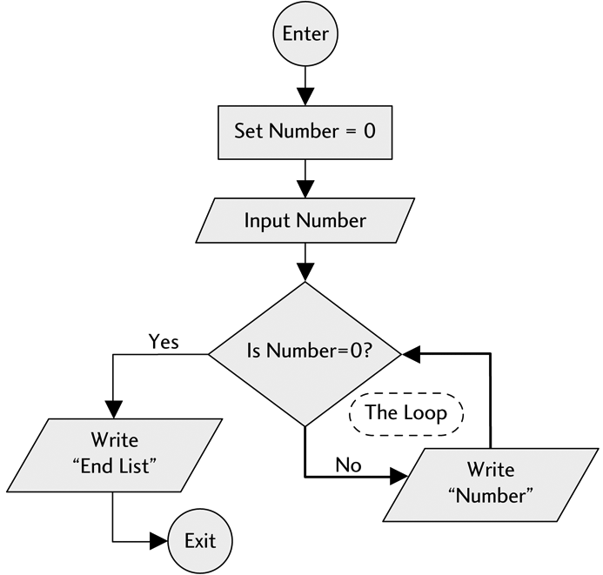
Flowchart for a Simple Repetition Structure (a Loop):

Slide 12
5.2 Types of Loops

Slide 13
5.2 Types of Loops (1 of 2)
Loops are one of the most indispensable tools of any programmer.
Loops are used to load data, manipulate data, interact with the user, and much more.
Loops come in various types. One type may work well for one specific program’s need while another type fits a different program design.
A programmer needs to understand be able to use the different types of loops.
Loops can be divided into two fundamental types: pre-test loops and post-test loops.

Slide 14
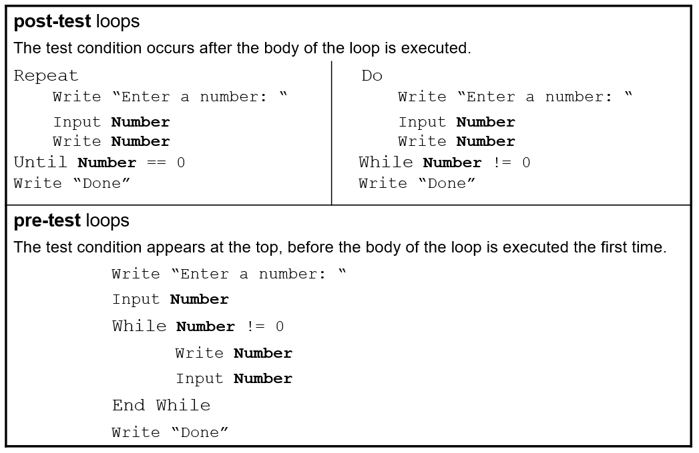
5.2 Types of Loops (2 of 2)

Slide 15
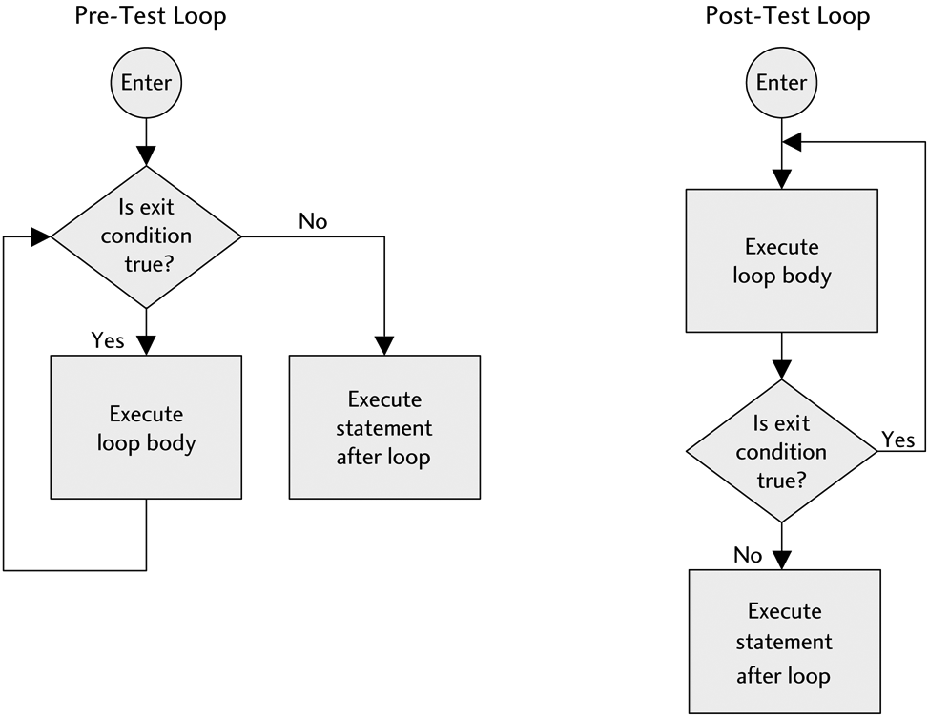
Flowcharts for Pre-test and Post-Test Loops

Slide 16
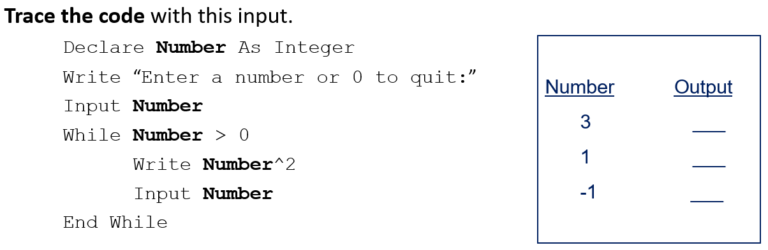
Trace a Loop: Walk through the loop manually
It is very hard to see what a loop is doing without tracing it to see how it works.
Suppose the user enters: 3, 1, -1.
Trace the code with this input.

Slide 17
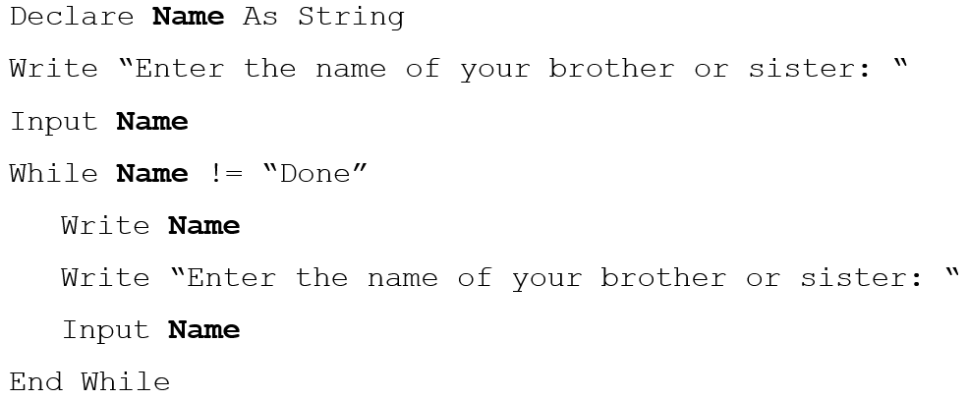
Using a Pre-test Loop Wisely
Previously the program to list the brothers and sisters of a user always ended with the output “Done” (i.e, the test condition).
A pre-test loop can be used to avoid having unwanted data:

Slide 18
Counter-controlled Loops
Define a counter: the counter is a variable.
It is always an integer
Common variable names are: counter, Count, I, or j.
Initialize the counter: set the counter to a beginning value.
To count by ones, the computer takes what it had before and adds one.
The code for a computer to count by ones looks like:
Count + 1
Store the new value: store it where the old value was.
If we are counting up by ones, we store the new value by the statement:
Count = Count + 1

Slide 19
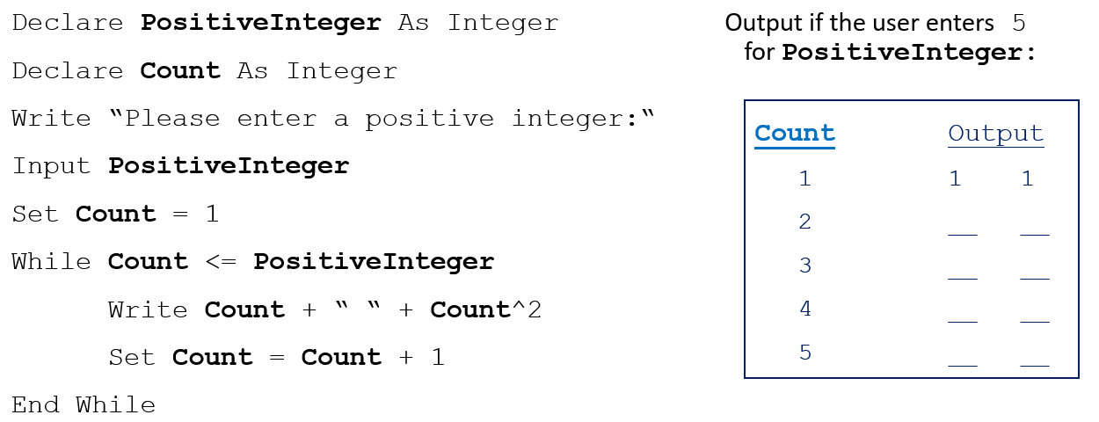
Example: Use a Counter to Display the Squares of Numbers

Slide 20
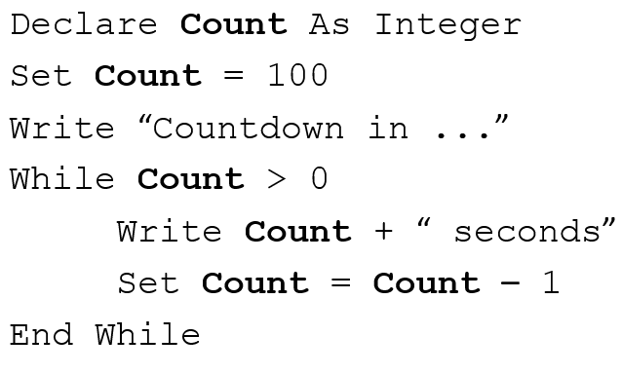
Counters Count Up and Down
Here is an example of using a counter in a loop to count down.
Countdown to Blastoff:

Slide 21
5.3 The For Loop

Slide 22
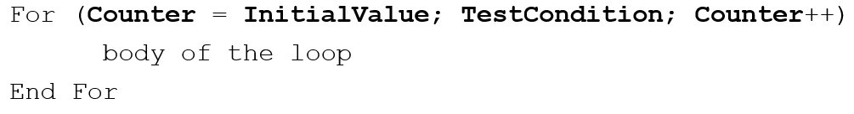
5.3 The For Loop
Most languages have a shortened method, called a For loop, to initialize the counter; increase or decrease the counter; and to tell the computer when to stop.
We use the following pseudocode in our For loop:
Counter equals the specified InitialValue
Counter increments by 1 (in this example) on each pass through the loop.
Counter++ acts just like the statement Counter = Counter + 1
This continues until the TestCondition is met

Slide 23
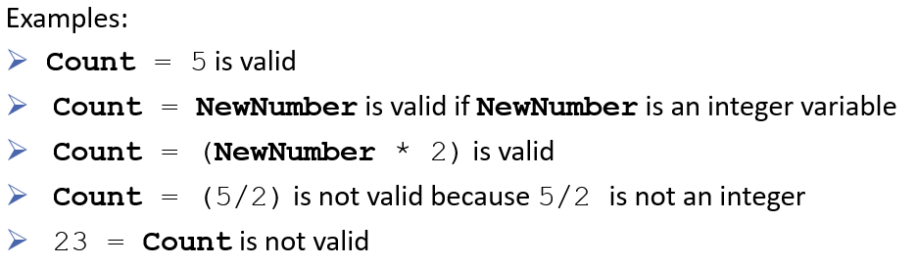
The Initial Value in a For Loop
The initial value can be:
any integer constant, such as 1, 0, 23, or –4
another numeric variable
set equal to an expression containing a numeric variable and a number
such as Count = (LowNumber + 3)
The counter itself must be a variable and the initial value must be an integer.

Slide 24
The Test Condition in a For Loop (1 of 2)
The test condition asks, “Is the counter within the range specified by this condition?”
If the test condition is Count < 10:
If the answer is “yes” then the loop executes again.
If the answer is “no” then the loop is exited.
When Count is equal to 10, the loop will be exited.
However, if the test condition is Count <=10:
The question is, “Is the value of Count less than or equal to 10?”
The loop will not be exited until Count is at least 11.

Slide 25
The Test Condition in a For Loop (2 of 2)
The test condition is checked at the end of a loop in a post-test loop and at the beginning in a pre-test loop.
In a For loop, the test condition is checked at the beginning. If the initial value of the counter passes the test condition, the loop is entered once. After the loop body executes once, the counter is then either incremented or decremented and the test condition is checked again.

Slide 26
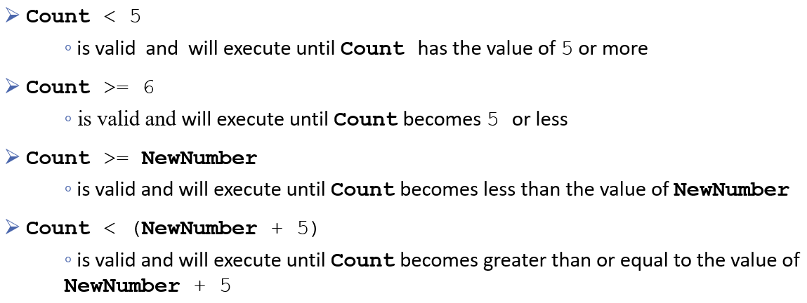
More About the Test Condition
The test condition can also be a number, another variable with a numeric value, or an expression containing variables and numbers. For example:

Slide 27
The Increment/Decrement Statement
The Increment or Decrement statement is like:
Count = Count + 1 or Count = Count – 1
Many programming languages use a shorthand method. We will use:
Count++ increments the variable named Count by 1 (i.e., counts up)
Count–– decrements the variable named Count by 1 (i.e., counts down)
To increase or decrease a counter by any integer other than 1, we will use the shorthand:
Count+2 increments Count by 2
This shorthand is comparable to Count = Count + 2
Count–3 decrements Count by 3
This shorthand is comparable to Count = Count – 3
Count+X will increase Count by the value of X
Count–X will decrease Count by the value of X

Slide 28
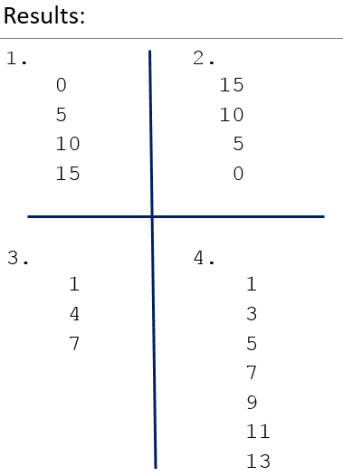
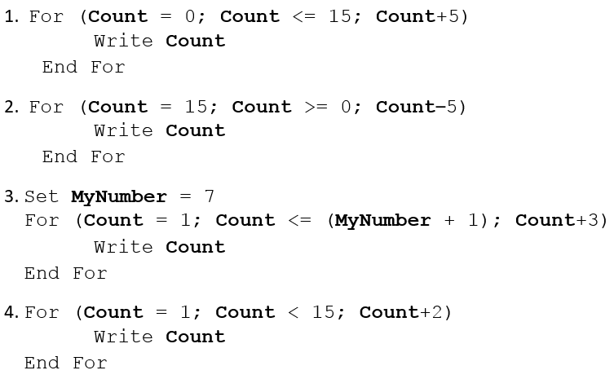
Examples

Slide 29
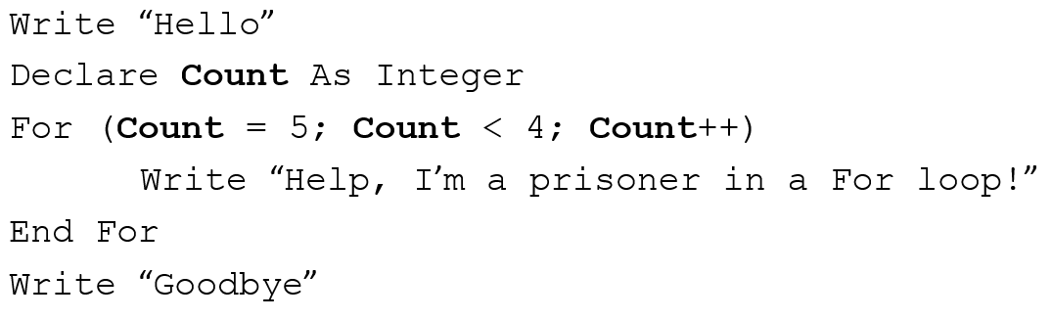
The Prisoner in the Loop
If the loop increment is positive and the initial value is greater than the limiting value, then the body of the loop is skipped as follows:

Slide 30
5.4 Applications of Repetition Structures

Slide 31
5.4 Applications of Repetition Structures
Loops have many purposes. This section will cover a few:
Use to input data
Data validation
Using the Int() or Floor() and Ceiling() functions
Computing sums and averages

Slide 32
Sentinel Controlled Loops
Loops are often used to input large amounts of data.
On each pass through the loop, one item of data (or one set of data) is entered.
The test condition must cause the loop to be exited after all data has been input.
Often the way to force a loop to end is to have the user enter a sentinel value to signal that input is complete.
The sentinel item (or end-of-data marker) should be chosen so that it cannot possibly be mistaken for actual input data.
A sentinel-controlled loop uses a sentinel value to determine whether or not the loop is to be exited.

Slide 33
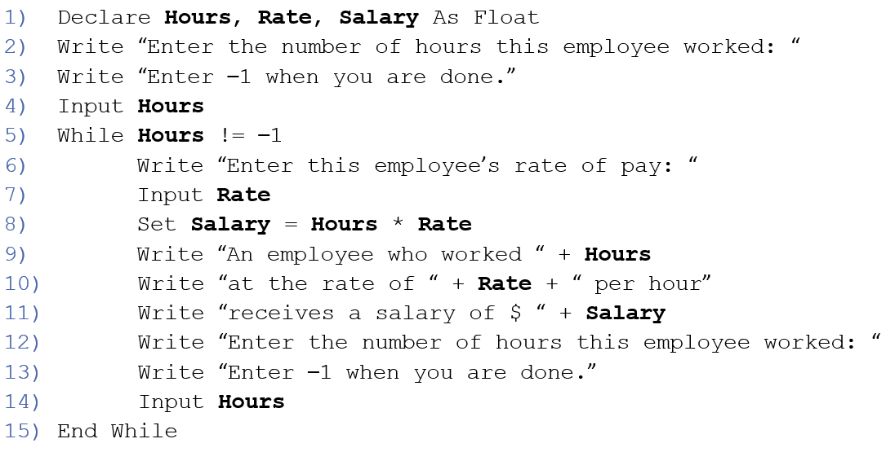
Sentinel Controlled Loop Example

Slide 34
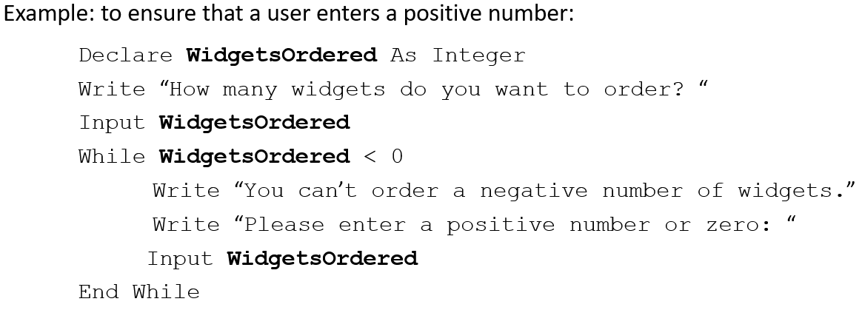
Data Validation: Loops Are Often Used to Validate Data Entered by a User

Slide 35
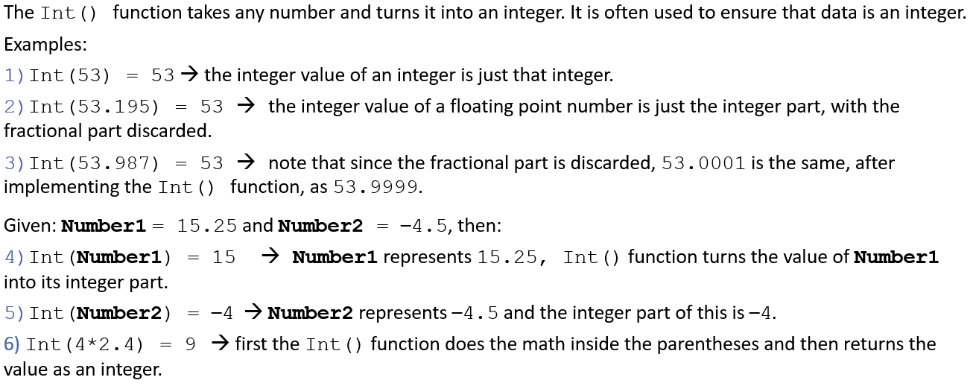
The Int() Function

Slide 36
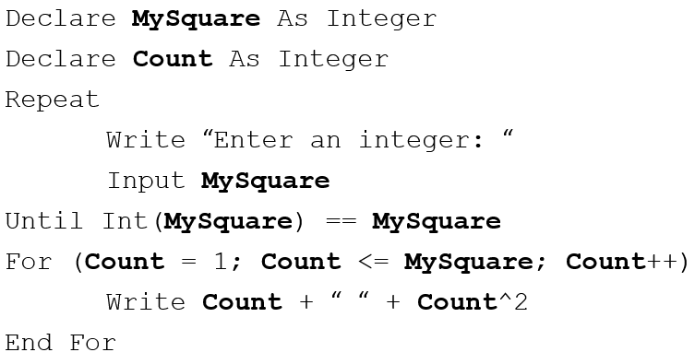
Using the Int() Function for Data Validation
This program segment first validates the input to make sure it is an integer. Note how it uses the Int() function and a loop to do this. Once the valid input has been entered, a For loop is used to display the squares of the numbers from 1 up to and including the number input.

Slide 37
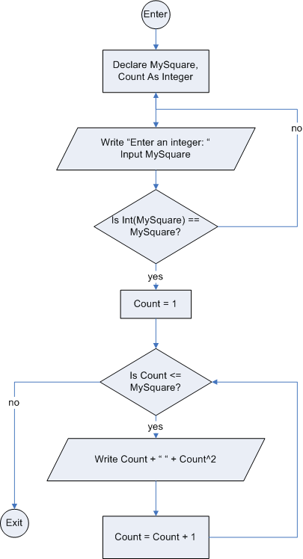
Flowchart for using the Int() function for data validation

Slide 38
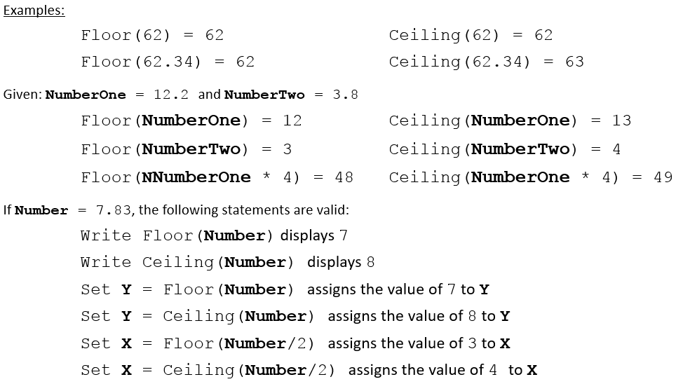
The Floor() and Ceiling() Functions
Floor() takes any number and discards the decimal part (i.e., it “rounds down”)
Ceiling() takes any number and “rounds up” to the next integer
Like Int(), Floor() and Ceiling() accept numbers, variables, and expressions

Slide 39
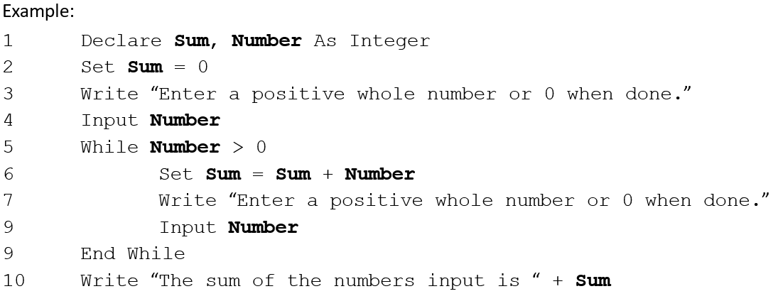
Using a Loop to Compute a Sum
Note: the variable Sum is known as the accumulator because it accumulates the values of the inputs.

Slide 40
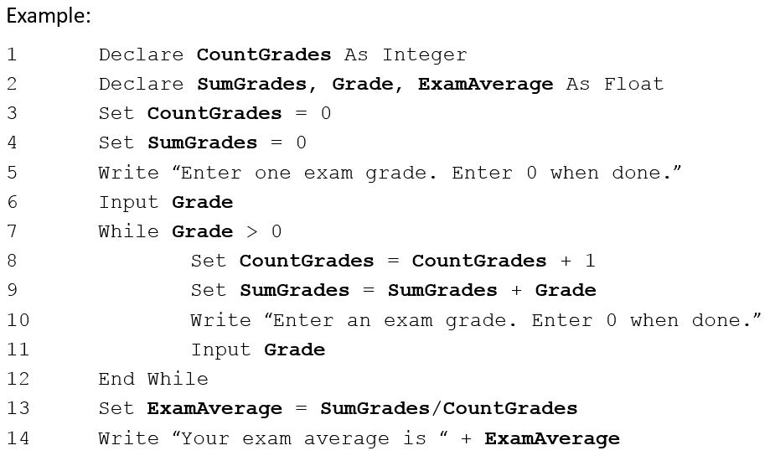
Computing Averages

Slide 41
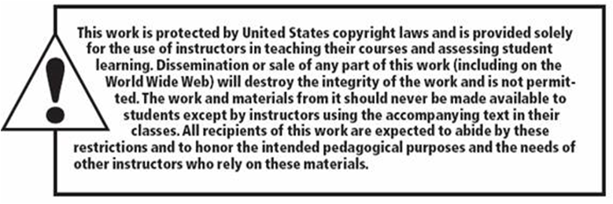
Copyright

